Slide 1
Developing a Machine Learning Model
ISDS 7075 Summer 2025 Taylor Kocher, Ryan McGiffin, Eric Lekas, Cameron Slaugh

Slide 2

About the Dataset
Chicago Police Department’s Citizen Law Enforcement Analysis and Reporting (CLEAR) system
Contains geographical information, outcome of crime (arrest) and/or whether it was a domestic dispute
Utilized 2016 data to create a Machine Learning (ML) model

Slide 3
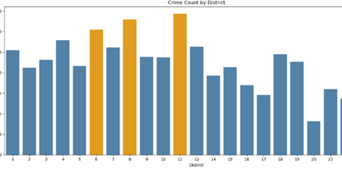
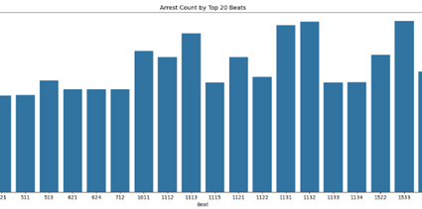
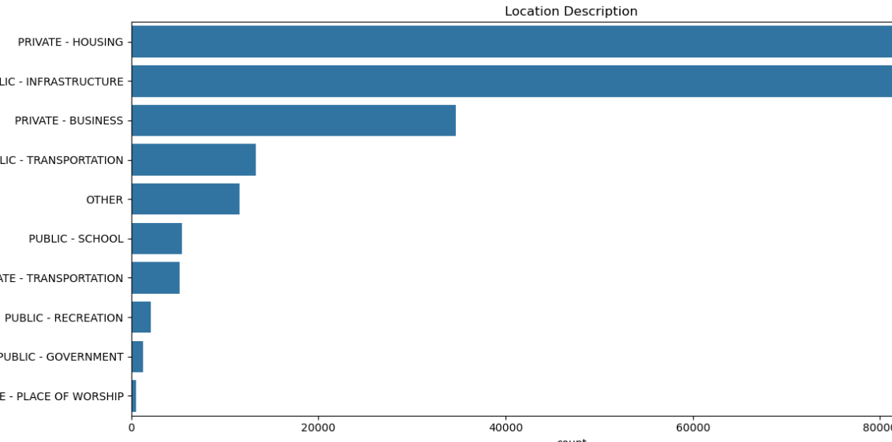
Frame the Problem
Data can be utilized to answer various business objectives
# of Crimes by Location
# of Crimes by District
# of Arrest by Beat
Main Objective of ML Model: predict the likelihood of an arrest based on various factors, such as type, location, and time of day

Slide 4
Initial Thoughts & Assumptions
Violent crimes to lead to more arrests
Drug-related crimes have a high number of arrests
Crimes that happen in the summer or during the afternoon result in more
School grounds would have more violent crimes
Most crimes happen in public places connected to infrastructure, as well as in private homes, along with a higher proportion of violent crimes
Notes:
Before building our model, we made several assumptions based on what we already know about crime and a first look at the data. We expected violent crimes to lead to more arrests because they are more serious and get more police attention. We also thought drug-related crimes would have a high number of arrests since police often target those specifically. Crimes that happen in the summer or during the afternoon were assumed to result in more arrests, since there are usually more people around and more police activity at those times. We believed that school grounds, especially public schools, would have more violent crimes, even if the total number of crimes there is low. Finally, we expected most crimes to happen in public places connected to infrastructure, as well as in private homes, and that these areas would also have a higher proportion of violent crimes compared to non-violent crimes. These ideas helped guide how we prepared the data and what we looked for in our model.

Slide 5

Data Wrangling
Dropped unnecessary columns
Updated data types
Removed rows with missing values
Binned data
Split testing and training data
Data visualization
Notes:
To get the dataset ready for modeling, we followed a thorough data wrangling process.
First, we dropped unnecessary columns like ‘Year’, which was redundant since all records were from 2016, and others like ‘Case Number’ and ‘X Coordinate’ that didn’t add value to our model.
Next, we updated data types to match the context. Fields like 'District' and 'Ward' were stored as floats but were changed to integers, and the 'Date' field was converted from an object to a proper datetime format.
We then removed rows with missing values, primarily those missing latitude, longitude, or location descriptions. These made up just over 5% of the dataset and didn’t have an obvious way to be imputed, so we dropped them to maintain the quality of the data.
After that, we worked on binning several variables to simplify the dataset while preserving meaning. For example, we grouped 127 unique location descriptions into 10 broader categories, reduced 31 crime types to 13, and binned hours of the day, days of the week, and seasons to observe patterns in when crimes occur.
Once the data was clean, we split it into training and testing sets, using 75% for training and 25% for testing. Because of the dataset’s large size, this split still left us with a robust test set, and we used a random state of 42 to keep it consistent.
Finally, we used data visualization throughout to guide decisions. Visuals helped identify trends, such as peak crime hours and the arrest likelihood by district or crime type, which helped inform both feature engineering and model building.

Slide 6
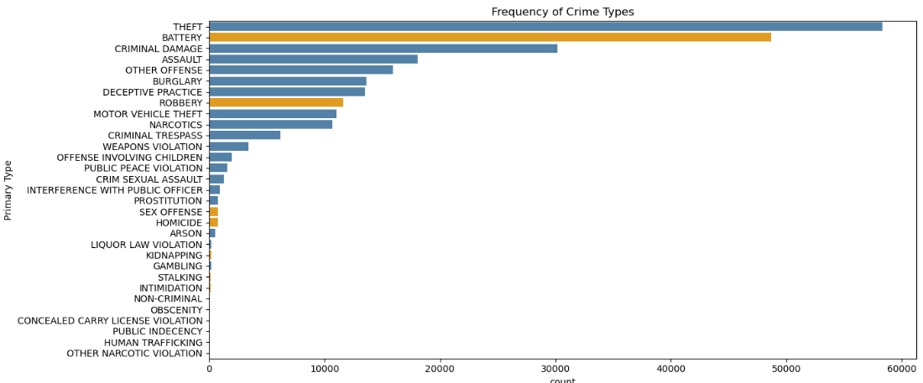
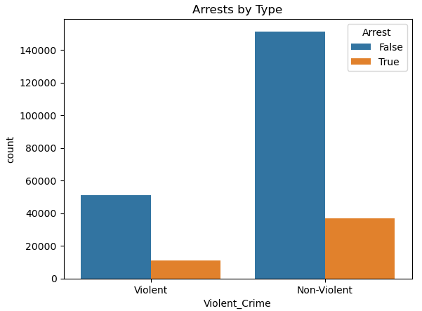
Exploratory Data Analysis
Arrests by Type
Most crimes do not result in arrests
Non-violent crimes retain highest frequency
Violent crimes show the highest arrest rate
Frequency of Crime
Theft is the most frequent crime
Battery is the most common violent crime (orange)
Notes:
Looking into the breakdown of violent and non-violent crimes, we began with a basic bar chart to help gain a general overview of the variable. The “arrests by type” chart showed most crimes do not result in arrests, non-violent crimes have the most volume, and violent crimes have the highest arrest rates. We then created a second chart to break down crime frequencies—non-violent crimes in blue and violent crimes in orange. This helped the group gain a deeper understanding of specific crimes that are most common, while reinforcing the previous finding that most arrests for crimes are non-violent.

Slide 7
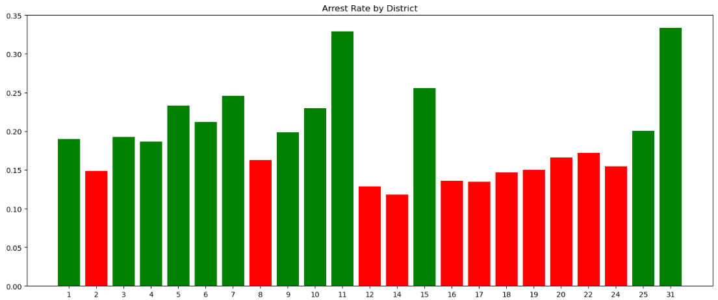
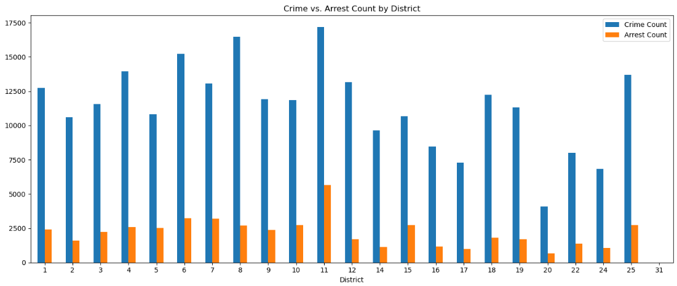
Exploratory Data Analysis
Crime vs. Arrest Count
Districts 6, 8, 11 each have crime counts greater than or equal to 1500
Districts 20 and 31 have the lowest volume of crime
Arrest Rate by District
Green bars indicate a “safe” district based on the median measure of arrest count / crime count
Overview of District and Crime graphs
District 11 has the highest arrest and crime count
High crime does not always mean high arrest rates
Helpful benchmarks for experimentation and model prep
Notes:
Continuing with the eda process, we analyzed how crime and arrest counts vary by district. The two graphs displayed work together: the first provides a side-by-side comparison of crime and arrest counts, while the second breaks this down into arrest rates by district-- using red to indicate whether a district falls below the median arrest count. Notably, district 11 has the highest crime and arrest counts but this does not always mean high arrest rates, as shown by district 8 with a similar number of crimes. While these graphs were not directly used in the feature engineering process, they offer valuable context. Should the predictive model underperform, we can revisit district level dynamics to dissect and potentially treat certain districts as outliers, but for now we are ready to move into the modeling phase.

Slide 8
Model Evaluation

Slide 9
Modeling Cycle
Preprocessing Pipeline
Model Selection
Initial Model Evaluation
Specify Model Parameters
Tuning
Determine Best Model
Notes:
The steps outlined in this slide were taken to prepare, select, evaluate, and determine the best model. Throughout these stages, we applied a variety of selection and optimization techniques to efficiently and effectively determine the best model for our problem.

Slide 10
Preprocessing Pipeline
Handle
Handle Missing Values
Specify
Specify Imputation Methods
Scale
Scale Numerical Features
Transform
Transform Categorical Features
Notes:
A preprocessing pipeline was developed to prepare the data for the models we had decided upon. This pipeline specifies how to handle missing values, whether they are to be ignored or imputed, and how to calculate imputed values. This is also where categorical and numerical features are transformed for compatibility with selected models. Finally, we also use the pipeline to scale the numerical features being evaluated. This ensures that all numerical features carry equal weight and one will not influence the model more than any other.

Slide 11
Model Selection
Decision Tree
Logistic Regression
Gradient Boosting
Random Forest
Notes:
A mix of simple and ensemble models were selected to be evaluated to allow for broad comparison. A decision tree model was selected for its simplicity. To contrast the decision tree model, we selected a logistic regression model. While decision trees are more susceptible to overfitting, logistic regression models are not. The same can be said for resilience to small nuance in the data. Logistic regression is more resilient to these small fluctuations in training sets. We then built upon the decision tree principle by selecting gradient boosting and random forest models. Gradient boosting and random forest models use the decision tree approach but improve and iterate upon it in different ways. For example, a random forest model consists of a series of individual decision trees which are combined once developed to form the resulting final model. Gradient boosting models are also an ensemble of decision trees, but they iterate through combinations of decision trees while also developing new trees.

Slide 12
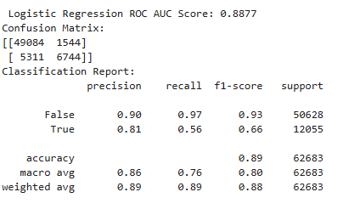
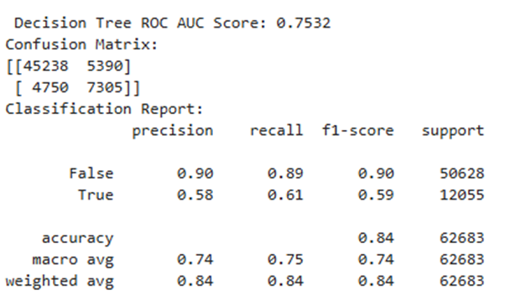
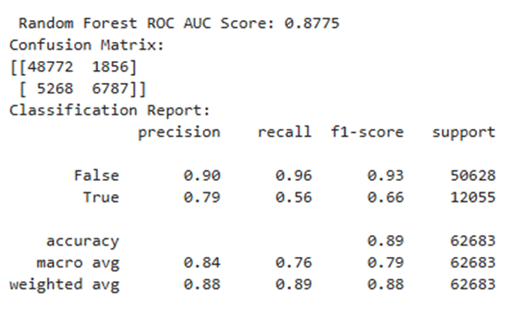
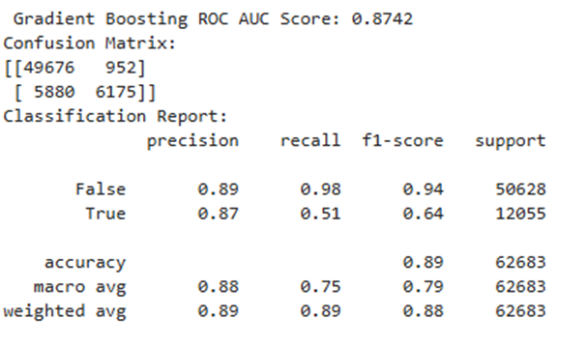
Model Results
Notes:
After building our four models, we evaluated each one using three key metrics: accuracy, AUC, and F1 score.
Logistic regression performed the strongest overall. It had the highest AUC and F1 score, which told us it was not only good at distinguishing between arrests and non-arrests, but also balanced precision and recall well.
The decision tree had the lowest performance across all metrics, likely due to overfitting and its limited ability to generalize.
Random forest performed about the same as the logistic model but still didn’t surpass logistic regression in AUC.
Gradient boosting had roughly the same accuracy, but its F1 score was lower for true cases, indicating it wasn’t as reliable for predicting whether an arrest occurred.
These results suggested that simpler models, like logistic regression, could be more effective with this dataset, especially considering the relationships in the data appear to be largely linear.

Slide 13
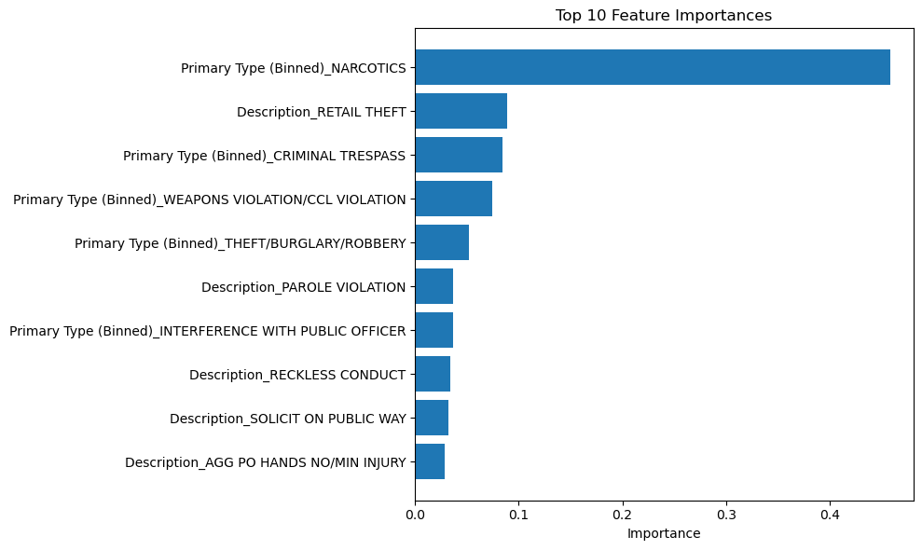
Feature Importance Evaluation
Primary Type produced the largest influence on model prediction.
Primary Type also occupies 4 of the top 5 most important features.
Significant drop in importance after 5th feature.
Description consistently has 2nd largest impact on prediction.
Notes:
After evaluating how our models performed, we analyzed which features had the greatest impact on prediction accuracy.
The most influential feature was Primary Type, particularly the binned category representing Narcotics offenses. This category alone had the strongest influence on whether an arrest was predicted.
On top of this, Primary Type appeared four times in the top five features, showing just how much the type of crime shapes arrest likelihood in the models.
The Description variable ranked as the second most important feature, proving that aside from Narcotics, it was the most influential feature on our models.
After the fifth feature, we noticed another drop in importance, meaning most of the predictive power was concentrated in just a few key variables.
These results confirmed that both the type and context of a crime are crucial when predicting arrests and helped guide how we prioritized features in the next step of model tuning.”

Slide 14
Specify Model Parameters
Parameter Grid Built
Parameters Determined and Specified
Iterate Upon Results
Notes:
We first developed a parameter grid. This was done for a few different reasons. A parameter grid allows for collaboration and error-proofing by rigidly organizing and structuring the parameters for each model. This allows team members to experiment in concert without creating noise in the working file or potentially altering code elsewhere by accident. It also allows for easier comparison of the hyperparameters for each model against one another. This allowed the team to manually iterate and gain an understanding for how the models performance was impacted by changing parameters before a later step of systematic optimization.

Slide 15
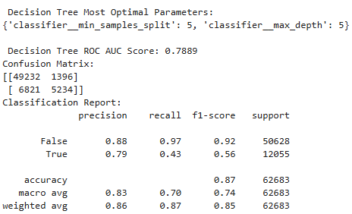
Modeling
Model Selection
Best model automatically selected during tuning evaluation
Tuned decision tree performed best
Logistic Regression Evaluation
Strongest fit for predicting arrest likelihood
Assumes linear relationships, matching data structure
Conclusion
Ensemble models did not outperform logistic regression—limited nonlinear complexities
Logistic regression recommended for real world implementation
Notes:
Behind the scenes, our code was formatted to select the best performing model based on optimal parameters, and in this case, the decision tree was the best tuned model with 5 samples split and a max depth of 5. However, for our primary objective—predicting the likelihood of an arrest, the logistic regression model proved to be a better fit. This aligns with the assumption that key features linearly influence arrest outcomes. While ensemble models like random forest or gradient boosting worked to capture hidden patterns, their performance suggests there were no significant nonlinear interactions in the data. In conclusion, logistic regression was the most reliable model for this classification task and would be the recommended choice for real world implementation.

Slide 16
Outcome
Understanding Arrest Patterns
Identifying arrest causes and patterns is a complex challenge
Predictive modeling is well-suited to generate insights
Real-World Impact
Supports data-driven safety strategies
Potential for more effective police resource allocation
Broader Implications
Classification is just the surface level—proactive crime prevention is the ultimate goal
Data science is very applicable to many real-world societal issues
Notes:
Identifying arrest causes and patterns is a complex, yet well suited challenge for predictive modeling, which can provide valuable guidance for improving safety and police resource allocation. Despite exploring advanced machine learning algorithms, we learned that simple models should not be overlooked. For future machine learning projects, modular pipelines will remain a core practice not only for interpretability purposes but also for flexibility in making modifications efficiently. Beyond predictive modeling, the real-world context of this problem is eye-opening. Since 2016, one in every six Chicago police officers has left the force. In 2018 alone, over 19,000 people were wounded in shootings, yet only 1,200 arrests have been made in connection with those incidents. We’re not just classifying outcomes; we’re aiming to guide proactive strategies in crime prevention. Our purpose for this assignment was not just about building a model but building a foundation which could support data-driven decisions and potentially save lives.

Slide 17
Citations
Ibm. (2025, June 4). What is Random Forest?. IBM. https://www.ibm.com/think/topics/random-forest
Lee, F. (2025, July 29). What is logistic regression?. IBM. https://www.ibm.com/think/topics/logistic-regression
scikit-learn developers . (n.d.). 1.10. decision trees. scikit learn. https://scikit-learn.org/stable/modules/tree.html
scikit-learn developers . (n.d.-c). Gradientboostingclassifier. scikit. https://scikit-learn.org/stable/modules/generated/sklearn.ensemble.GradientBoostingClassifier.html
Grimm, A., Schuba, T., & Boyle, A. (2025, March 14). “where’s my justice?” Only 6% of Chicago shootings lead to arrests, Sun-Times finds. Times. https://chicago.suntimes.com/the-watchdogs/2025/03/14/non-fatal-shootings-clearance-rate-chicago-police-cpd-statistics
Main, F., & Schuba, T. (2024, October 25). Chicago Police Department Exodus: New Cops are leaving in droves, Sun-Times Investigation finds. Times. https://chicago.suntimes.com/the-watchdogs/2024/10/25/chicago-police-department-exodus-suburbs-recruiting

